Slide 1
The Internet
Part 1: DNS Lookup and Information Transfer

Slide 2
1.
DNS Lookup
Let’s begin!

Slide 3

What happens when we type an address into the URL bar?

Slide 4
DNS (Domain Name Service)
How Does DNS Work - https://youtu.be/BCjUbpIzRs8
Goal: Turn www.google.com into 74.125.239.113.
Like an address, DNS “zooms in” by analyzing parts of the URL before others.
Before sending a package to the correct address, packages are first sent to the correct city.
What are the steps?
1. Send request to “.” root DNS server.
2. Send request to returned “.com” DNS server.
3. Send request to returned “google.com” DNS server.
4. This issues the location of “www.google.com” as 74.125.239.113.
5. Save address and continue communication with the correct IP.

Slide 5
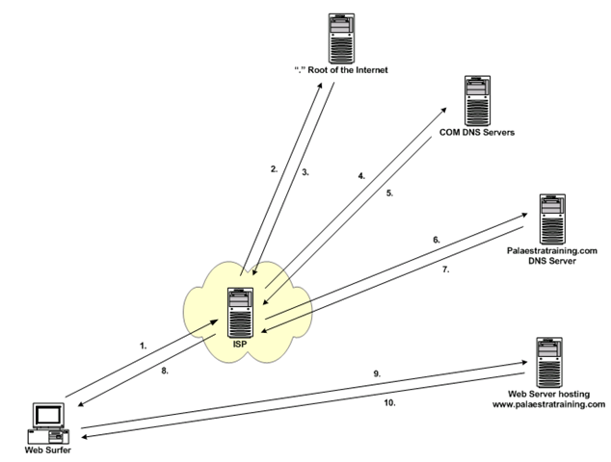
DNS
Notes:
Photo Credit: www.palaestratraining.com

Slide 6

What kind of vulnerabilities can you see with this system?

Slide 7
What can we do to prevent such an attack?

Slide 8
Information Transfer
How does Alice send a message to Bob over the internet?

Slide 9
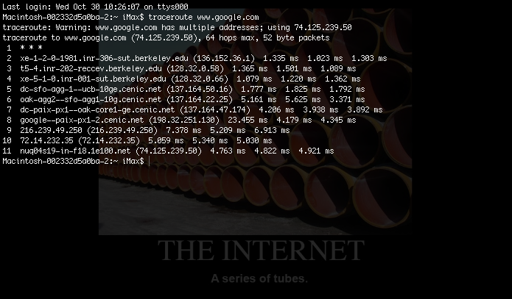
Traceroute from lab shows all the computers your information crosses before reaching the designated website “www.google.com”.
How could more “hops” increase the vulnerability of your communication?
Notes:
Photo Credit: www.palaestratraining.com

Slide 10
Packets
Akin to a letter containing an address with “delivery instructions” and some amount of information ~128 bytes total.
Used to carry pieces of your data in discrete packets.
Statistics:
3 MB song file requires 24,000 packets to send!
Over 700 billion packets sent every second worldwide!*
*Based on ~21 exabytes global data transfer each month.

Slide 11
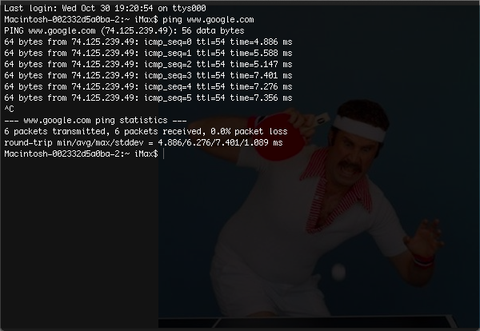
From lab - Ping times how long it takes to send and receive packets from a website.
Notes:
Photo Credit: www.palaestratraining.com

Slide 12
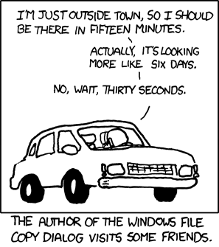
Delays
Packets are fast but not instantaneous.
Delays open windows for sneaky attacks.
Packet delays limit how much information can be transferred.
Can this delay compromise…
Reliability?
Confidentiality?
Integrity?
Authenticity?
Notes:
Photo credit to xkcd.com

Slide 13
1.
Thank you!

